Slide 1
Portable Ultrasound Device (PUD) for Coda-Wave Interferometry
Spring ‘24
Sprint 2
Prepared by Michael Kisellus, Christopher Coppedge,
Leyton Foxworthy, Matthew Baker, Kyle Fox
Product owner : Dr. Brown
06 MAR 2024

Slide 2
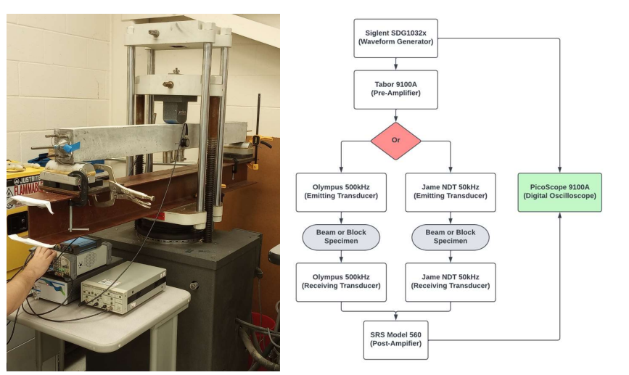
Project Overview - Background
Civil engineering lab has a concrete “scanning” process that involves measuring how ultrasonic waves travel through the concrete

Slide 3
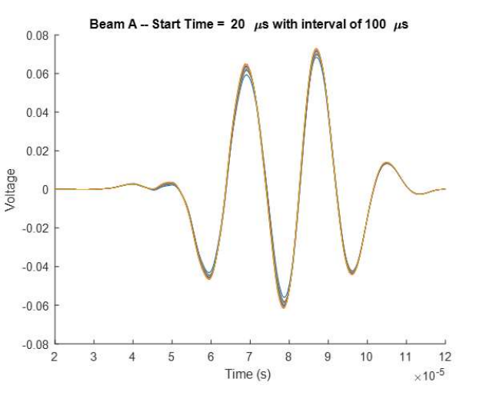
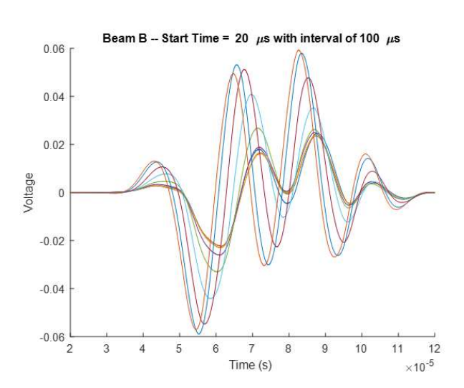
Project Overview - Background
Data analysis, using MATLAB, can reveal imperfections in the concrete.
Scan of an undamaged section of concrete
Scan of a compromised section of concrete

Slide 4
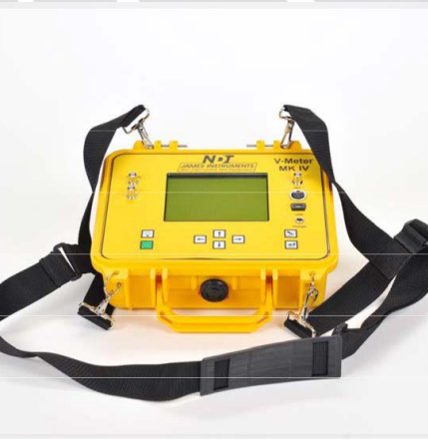
Project Overview - Purpose
Produce a handheld ultrasound inspection device for inspecting a bridge/structural component for faults in the field.
Inspection Unit gathers and stores test data collected over time (48 to 72 hours).
Budget - $2000
Rationale:
Existing commercial solution is expense (~ 5000 USD)
Existing solution cannot operate without operator present.

Slide 5
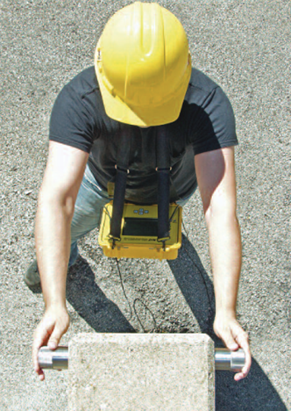
Project Overview - Requirements
The Portable Ultrasound Device (PUD) shall:
Be portable and usable by a single operator.
Initiate testing and record the resulting data.
Operate for 48 to 72 hours without exterior inputs.
Operate in outdoor/ field environment

Slide 6

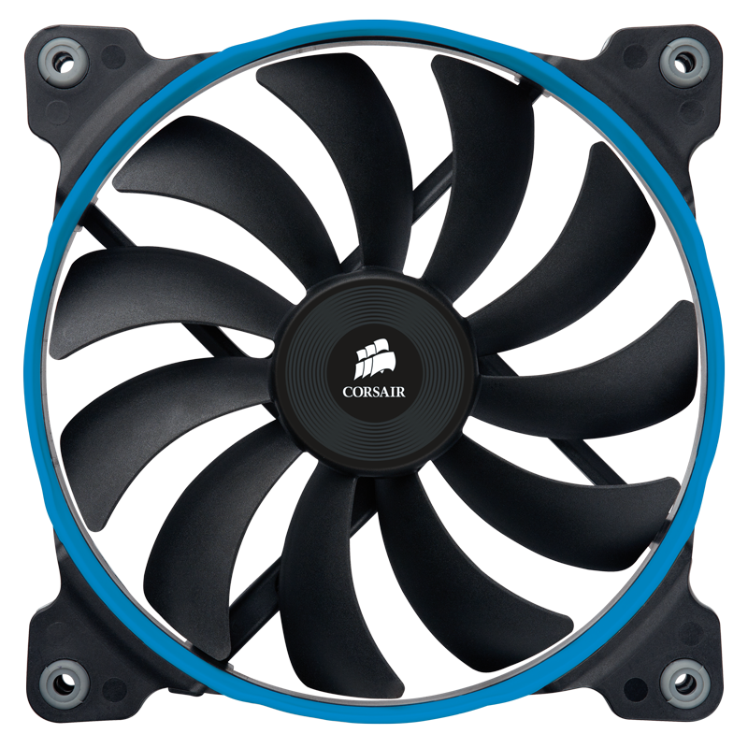

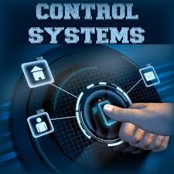
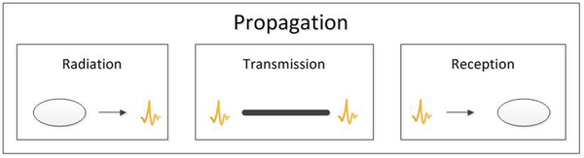
Project Overview - Subsystems
Hardware
Electrical system
Enclosure and Mounting system
Cooling system
Software
Transmit (Tx) and Receiver (Rx) system
Control system

Slide 7
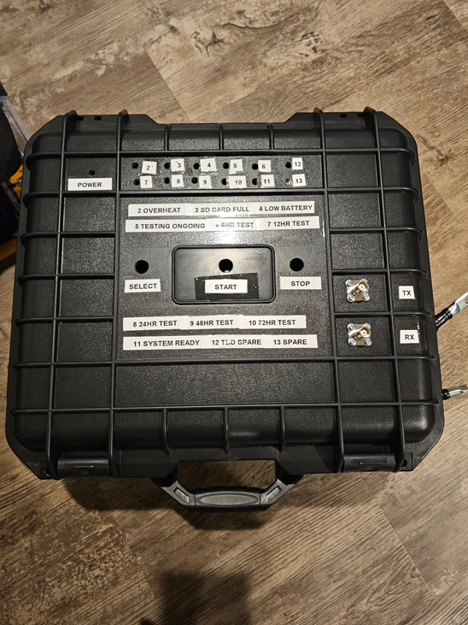
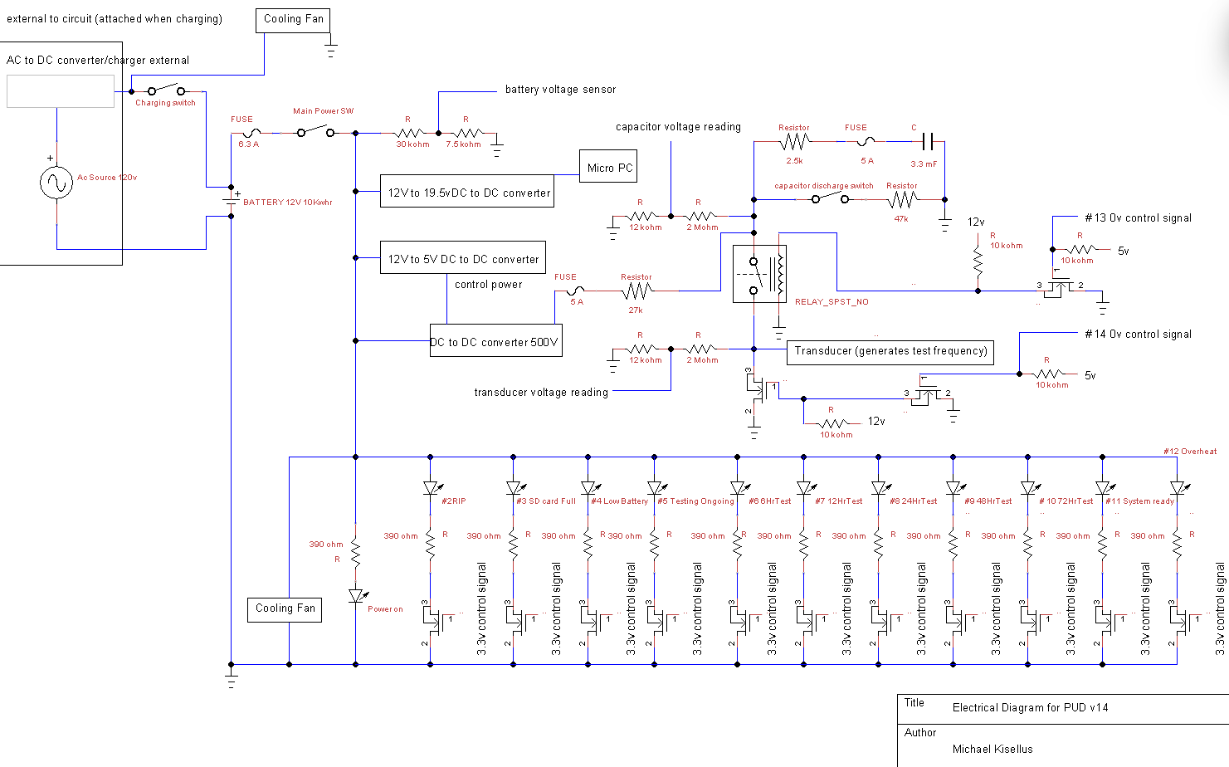
Project Overview - Work Completed
Fall ‘23:
Overall design and conceptual work.
Subsystem Progress
Electrical
Wire and construct circuits for 5V, 12V, 500V sections
Cooling
Obtain cooling fans and fan controllers
Software
Demo ADC and GPIO capabilities of Pi pico microcontroller
Demo capabilities of Thonny to control windows
Hardware
Labels created and mounted to casing
Indicating lights, switches, and exterior locks

Slide 8
Sprint 2 Backlog Status
Completed:
Electrical
[Replace with current status]
Cooling
Solder and Wire EMC2101 Driver Boards
Mount fan covers
Software
[Replace with current status]
Hardware
Obtain and mount vent covers.
Remaining:
Electrical
[Replace with backlog]
Test battery life under simulated operation
Cooling
Attach mesh to fans to prevent wiring damage.
Mount fans.
Software
[Replace with backlog]
Hardware
Seal vent covers
Route cabling.

Slide 9
Progress for the
month and week

Slide 10
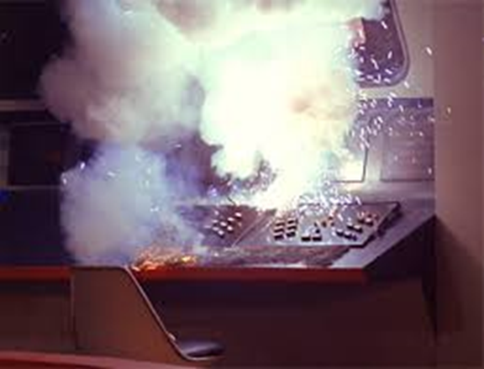
Risks and Roadblocks
Electrical shock (500v)
Electrical component failure
Internal space constraints for oscilloscope/computer
Power consumption possibly reducing operating window below 48 hr
Software reliability over 48 to 72 hr operation

Slide 11
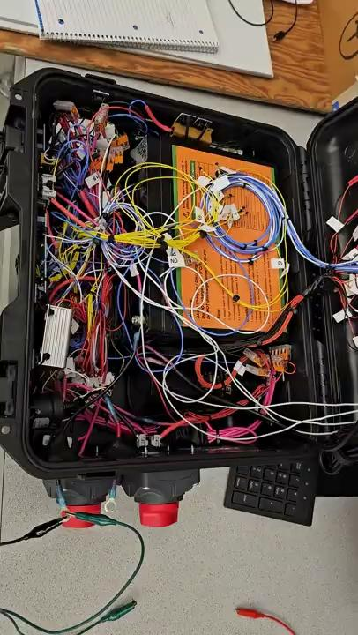
Visual Demo

Slide 12
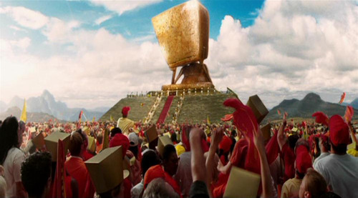

Questions?

